Slide 1
Emial classification
Supriya Mallidi Ramakrishna Dayala
Venkat Ranga Kanchum

Slide 2
Steps followed as part of this design
1. generate .eml files from JSON with all kind of attachment
2. extract all data from emails and its attachments and write it to mongo DB
3. now run trained llm model to classify records as update or request by reading subject and body of the email entries in db and by running trained llm on it
4. now for records which have label as request extract key feilds Customer name, SNN \Tin , Sender, request type, request subtype and loan amount and add it extracted_details to each record in DB
5. Run duplicate checker: create a has of extracted field and run it where customer SSN\TIN matches if that doesn't match then run it on sender email matches - and if hash matches mark them as duplicate file - this run on files older to current file only
6 now for records where duplicate is false run full extraction to extract all the required fieds from sub body and attachments
7 based on request type and sub request type map it to the users who are already mapped to request and sub request

Slide 3
Tech stack:
Core Components
Python 3.11+
PyTorch (Deep Learning Framework)
Transformers Library (Hugging Face)
DistilBERT (Pre-trained NLP Model)
Pandas (Data Handling)
Scikit-learn (Metrics/Evaluation)
MongoDB
Pymongo
Tesseract OCR

Slide 4
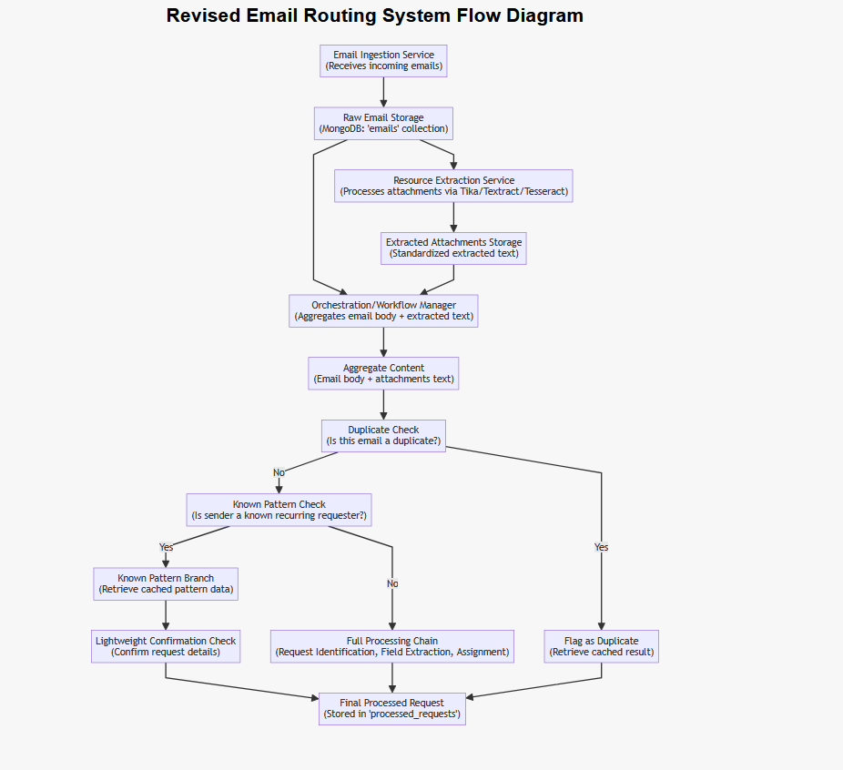

Slide 5
Challenges:
training the model
test data preparation
addressing deviation

